Slide 1
Digital Electronics

Slide 2
Type of Signal
Analog
Digital

Slide 3
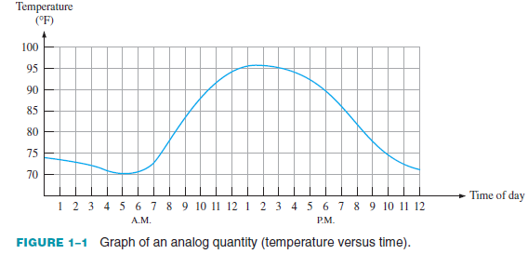
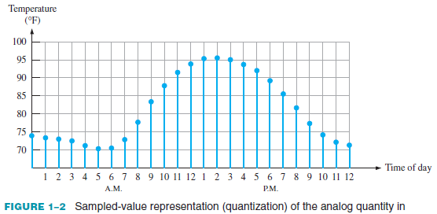
Analog to Digital

Slide 4
Advantage of Digital
digital data can be processed and transmitted more efficiently and reliably than analog data.
Storage is easy
Noise effect can be reduced

Slide 5
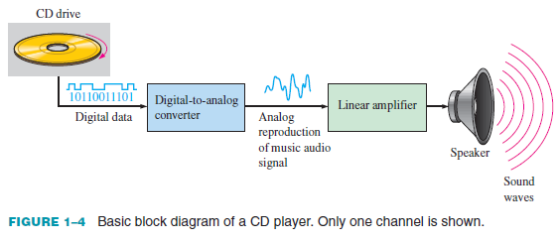
Example

Slide 6
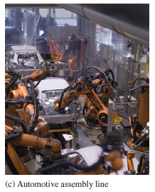
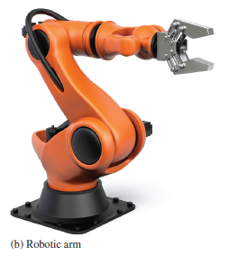
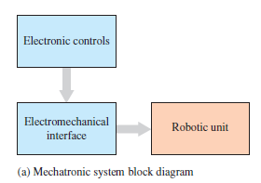
Example 2

Slide 7
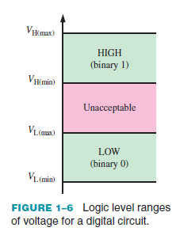
Binary Digits
Positive Logic
1 & 0 are called as Bit
HIGH=1 & LOW=0
Mostly discussed in our study
Negative Logic
1=Low
0= High

Slide 8
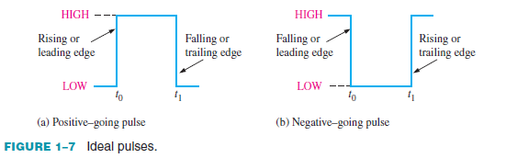
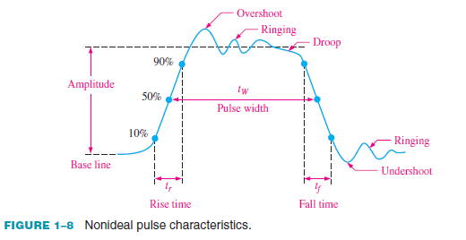
Ideal Vs Non-Ideal Digital Pulse

Slide 9
Number System
Decimal Numbers
Binary Numbers
Hexadecimal Numbers
Octal Numbers
Binary Coded Decimal (BCD)
Decimal-to-Binary Conversion
Complements of Binary Numbers
Signed Numbers

Slide 10
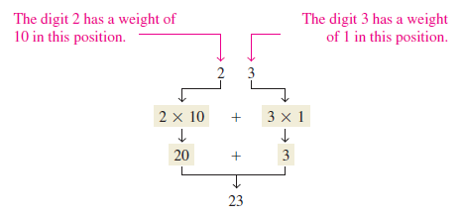


Decimal System
The decimal number system has a base of 10
Weighted structure

Slide 11

Binary Numbers
Weighted Number
The right-most bit is the LSB (least significant bit) in a binary whole number and has a weight of 2⁰ =1.
The weights increase from right to left by a power of two for each bit.
The left-most bit is the MSB (most significant bit);

Slide 12
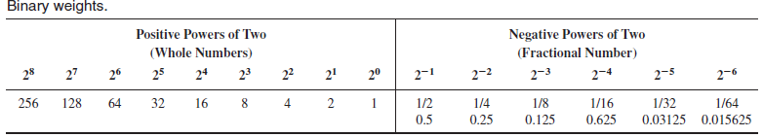
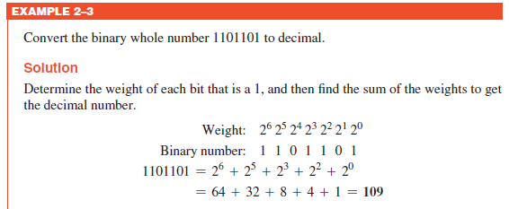

Slide 13
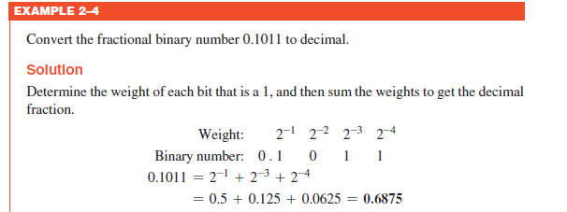

Slide 14


Decimal to Binary Conversion

Slide 15
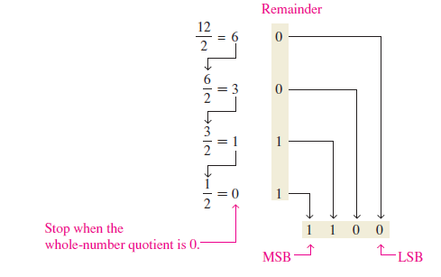

Slide 16
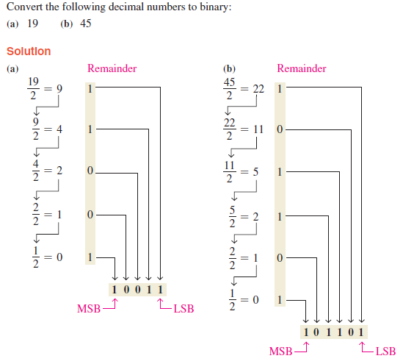
Example

Slide 17
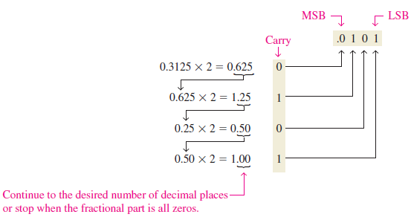

Slide 18
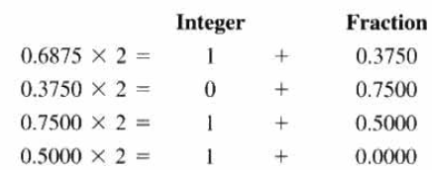
Example

Slide 19


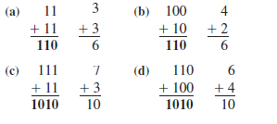
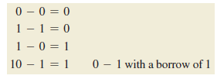
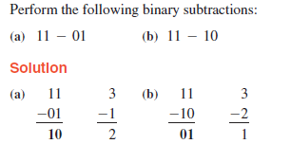

Slide 20
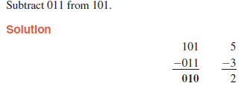
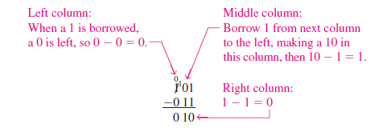

Slide 21
Complements of Binary Numbers
The 1’s complement and the 2’s complement of a binary number are important because they permit the representation of negative numbers.
The method of 2’s complement arithmetic is commonly used in computers to handle negative numbers.

Slide 22
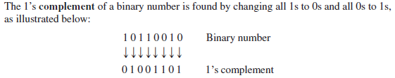

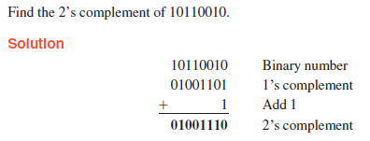

Slide 23


Signed Numbers

Slide 24
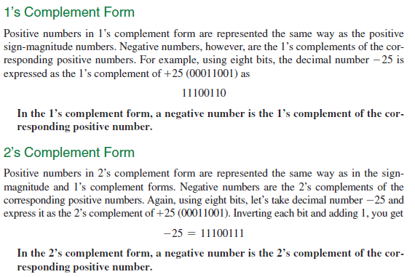
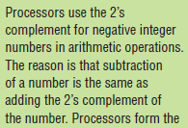

Slide 25
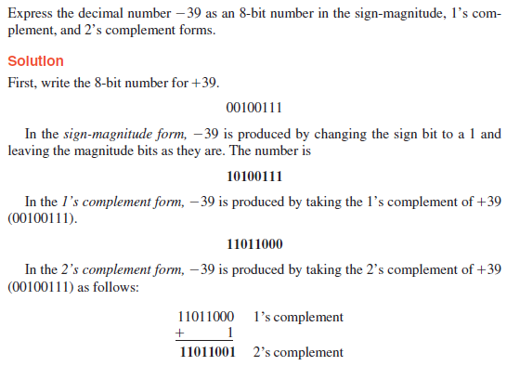
Example

Slide 26
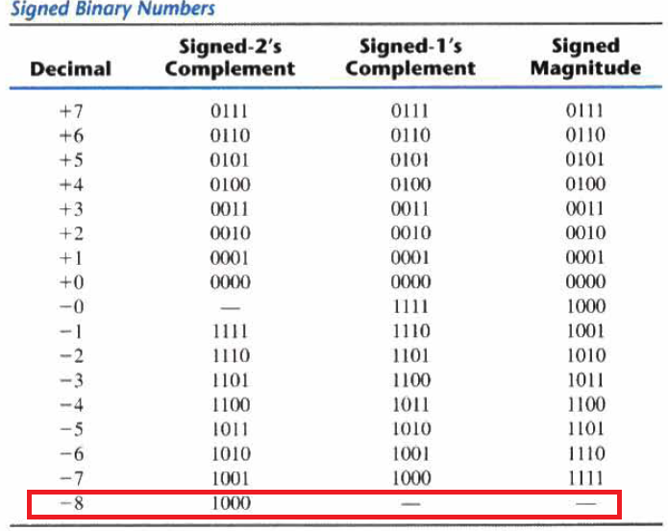


Slide 27
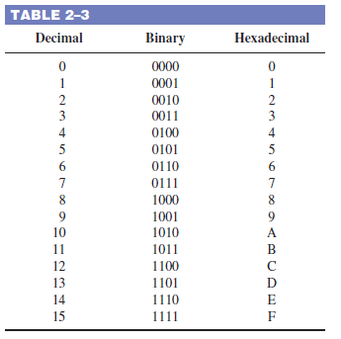
Hexadecimal Numbers
The hexadecimal number system has sixteen characters;

Slide 28
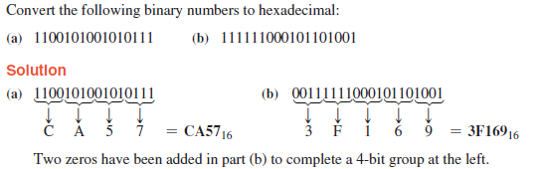
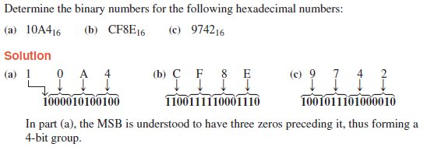

Slide 29



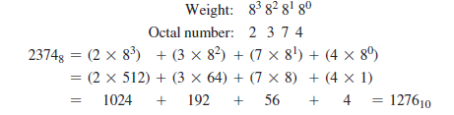
Octal Numbers

Slide 30
Logic gates

Slide 31
Various Logic Gates
NOT
AND
OR
NAND
NOR
XOR
XNOR

Slide 32

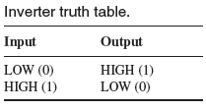

NOT Gate
performs the operation called inversion or complementation.
Also Called as Inverter

Slide 33

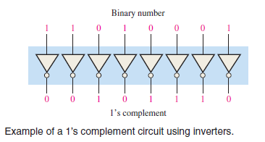
In Boolean algebra, which is the mathematics of logic circuits, a variable is generally designated by one or two letters although there can be more.
A variable can take on a value of either 1 or 0.

Slide 34

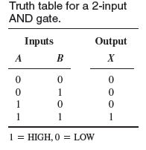
AND Gate
An AND gate produces:
HIGH output only when all of the inputs are HIGH.
Low output when any of the inputs is LOW

Slide 35
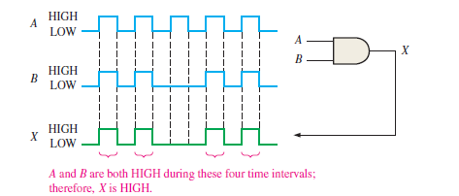
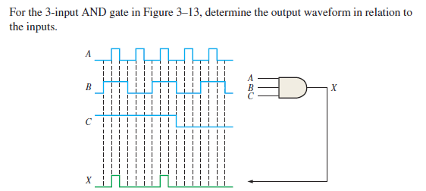

Slide 36
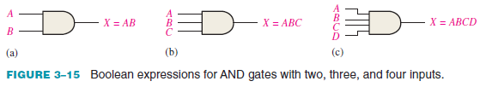
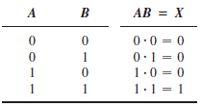

Slide 37

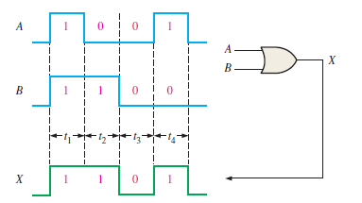
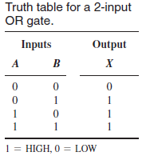
OR Gate
An OR gate produces:
HIGH on the output when any of the inputs is HIGH.
Low output when all of the inputs are LOW.

Slide 38


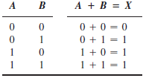


Slide 39

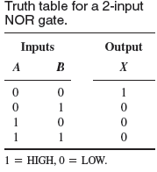
NOR Gate
The term NOR is a contraction of NOT-OR and implies an OR function with an inverted (complemented) output
A NOR gate produces a LOW output when any of its inputs is HIGH.

Slide 40
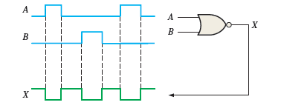
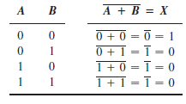

Slide 41

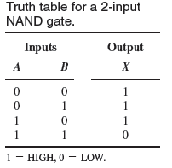
NAND Gate
The term NAND is a contraction of NOT-AND and implies an AND function with a Complemented (inverted) output.
For a 2-input NAND gate,
output X is LOW only when inputs A and B are HIGH;
Output X is HIGH when either A or B is LOW, or when both A and B are LOW.

Slide 42


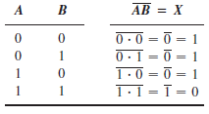

Slide 43
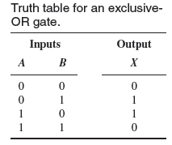

XOR (Exclusive-OR) Gate
The output of an exclusive-OR gate is HIGH only when the two inputs are at opposite logic levels.

Slide 44
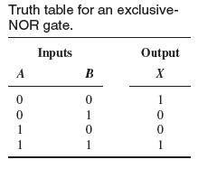

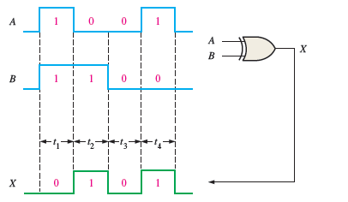
XNOR (Exclusive-NOR) Gate
Output is high when both the input are same

Slide 45
Boolean Algebra

Slide 46
Boolean algebra, like any other deductive mathematical system, may be defined with a set of elements, a set of operators, and a number of unproved axioms or postulates.
A = {1, 2, 3, 4} indicates that the elements of set A are the numbers 1, 2, 3, and 4.
A binary operator defined on a set S of elements is a rule that assigns, to each pair of elements from S, a unique element from S.
As an example,
consider the relation a*b = c. We say that * is a binary operator if it specifies a rule for finding c from the pair (a, b) and also if a, b, c ∈S.
However, * is not a binary operator if a, b ∈ S, and if c∉S.

Slide 47



Closure. A set S is closed with respect to a binary operator if, for every pair of elements of S, the binary operator specifies a rule for obtaining a unique element of S.

Slide 48



Slide 49


Boolean addition is equivalent to the OR operation

Slide 50


In logic circuits, a product term is produced by an AND operation with no OR operations involved.

Slide 51




Laws of Boolean Algebra

Slide 52





Slide 53



Slide 54



Slide 55





Slide 56





Slide 57




Slide 58



Slide 59



Slide 60





Slide 61



Slide 62



Slide 63


Slide 64





Slide 65


Slide 66


A product term isdefined as a term consisting of the product (Boolean
multiplication) of literals (variables or their complements).
When two or more product terms are summed by Boolean addition, the resulting expression is a sum-of-products (SOP).
Example:

Slide 67



Slide 68



Slide 69

A standard SOP expression is one in which all the variables in the domain appear in each product term in the expression.

Slide 70




Slide 71


Slide 72

A sum term is defined as a term consisting of the sum (Boolean addition) of literals (variables or their complements). When two or more sum terms are multiplied, the resulting expression is a product-of-sums (POS).
Example:

Slide 73



Slide 75


Slide 77


Slide 78

The binary values of the product terms in a given standard SOP expression are not present in the equivalent standard POS expression.
Also, the binary values that are not represented in the SOP expression are present in the equivalent POS expression.

Slide 79



Not available terms are : 001, 100, and 110
Remember, these are the binary values that make the sum term 0.

Slide 80




Slide 81


A Karnaugh map is similar to a truth table because it presents all of the possible values of input variables and the resulting output for each value.
The purpose of a Karnaugh map is to simplify a Boolean expression.

Slide 82



Slide 83



Slide 84



Slide 85



Slide 86


Slide 87



Slide 88



Slide 89



Slide 90



Slide 91




for these “don’t care” terms either a 1 or a 0 may be assigned to the output; it really does not matter since they will never occur.

Slide 92

For a POS expression in standard form, a 0 is placed on the Karnaugh map for each sum term in the expression.
The cells that do not have a 0 are the cells for which the expression is 1.

Slide 93



Slide 94



Slide 95



Slide 96


Slide 97


 | 00 | 01 | 11 | 10
00 | 0 | 1 | 3 | 2
01 | 4 | 5 | 7 | 6
11 | 12 | 13 | 15 | 14
10 | 8 | 9 | 11 | 10

